Slide 1
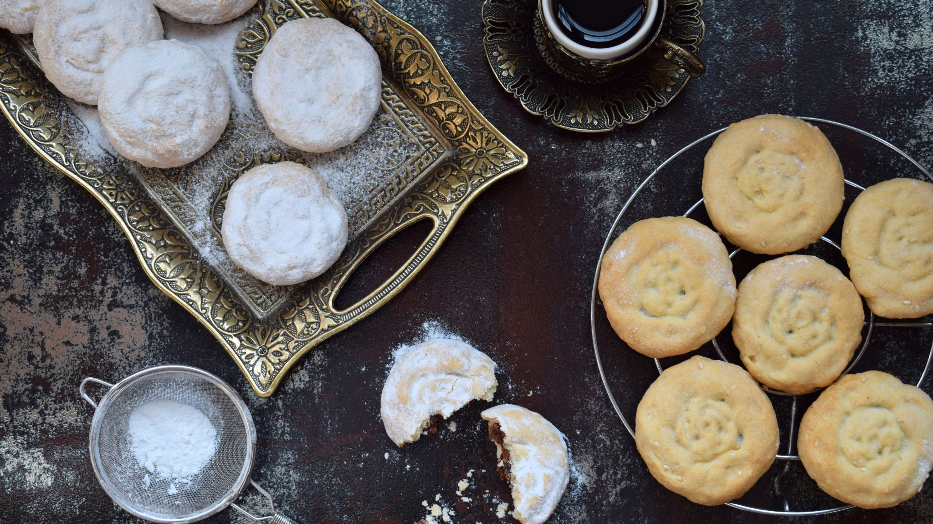
Bayley’s Favourite Baking Recipes
Name: Bayley Kryzanowski
Matriculation Number: 9218772
Course: Project: Java and Web Development
Course Number: DLBCSPJWD01
Phase 2: Development Phase
Tutor: Christian Remfert
Date: December 4, 2025
GitHub link: bayleykryzanowski/Baking_Recipes_App

Slide 2

Application Purpose and Concept
Name for Application: Bayley’s Favourite Baking Recipes
Purpose: Organize and store a personal, reliable, digital database for some of the best baking ideas at home. Be able to store, organize and easily retrieve favourite recipes. Can be edited for personal cooking notes and family recipes.

Slide 3
User Group and Benefits
User group: People who are interested in baking and have a need to keep their recipes stored safely in an online space with an organized, accessible system.
User Benefits:
Organization: Search and filter recipes by preparation time, ingredient or title.
Accessibility: Responsive web design will ensure recipes are readable and useable on all devices.
Security: Secure storage on the local back-end ensures data longevity and eliminates the risk of losing handwritten recipes.
Efficiency: Quickly look up instructions without having to sift through old papers or web-pages. Share, edit and delete recipes quickly.

Slide 4
Functional Requirements
Must be able to input a recipe and have it saved in the browser.
Must be able to view a list of all saved recipes and see essentials on summary cards.
Must be able to filter the displayed recipes by category and search by title or ingredient.
All submitted recipes must be saved to a local database on the back-end and be retrievable.
The layout must be responsive and adapt to different viewport size changed, maintaining usability on mobile devices.

Slide 5

Technical Components and Decisions
Architecture and Data Flow:
Front-end (Client): Handles the UI and collecting user input.
HTML, CSS, JavaScript for quick and effective responsive design that utilizes core web technologies.
API Request: Use JSON data to store back-end API.
Standardized and efficient communication protocol using a base URL.
Back-end(Server): Receives the HTTP request, processes the data and interacts with the storage layer.
Node.js with the express.js framework to provide a lightweight, fast and scalable runtime environment. Allows for use of plain JS across the entire stack.
Data Storage: The data is saved regularly.
Saving data locally using the Browsers’ File system module to avoid using a large setup.
API Response: The server send a response back to the client.
Client Update: JS uses the received data to dynamically update the we application.

Slide 6
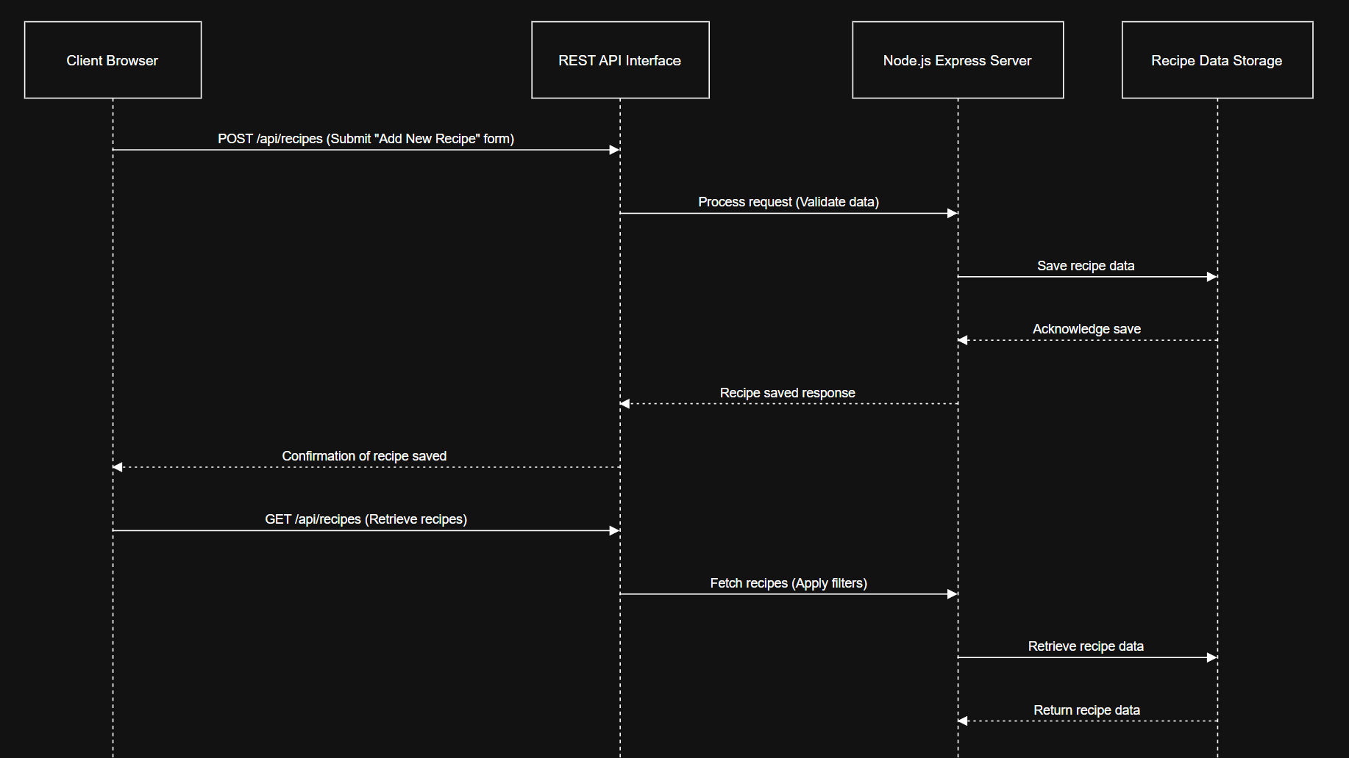

Slide 7

Title/Search Bar
Allows users to filter through recipes saved to the browser. The + Add New Button allows for auto-scroll to the form where the user can fill in their own new recipes.

Slide 8

Screenshots

Slide 9
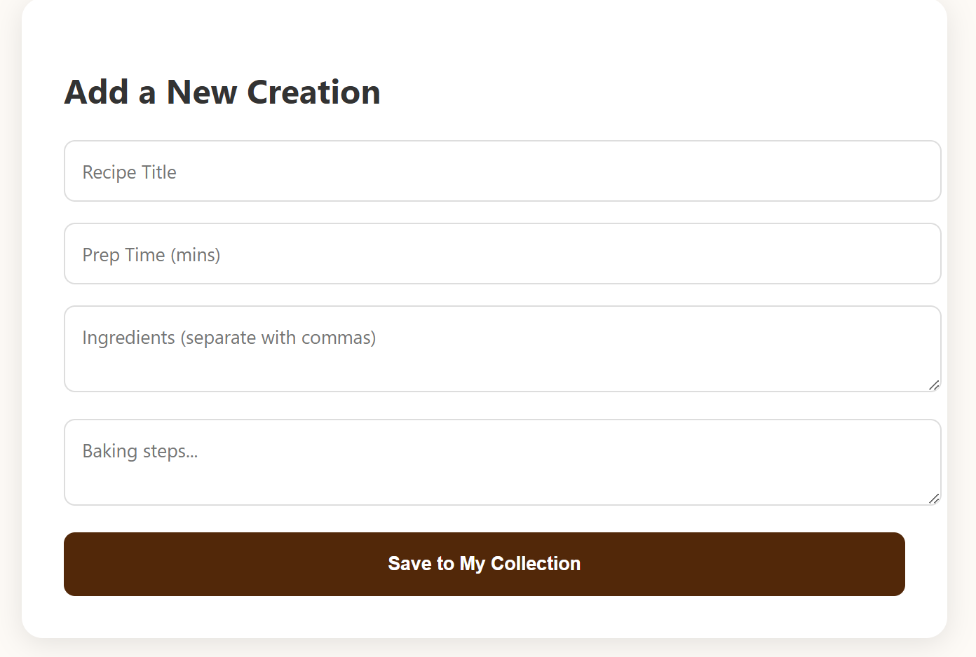
New Recipe
Users can add their own information here to create new recipes to be added to the collection!

Slide 10
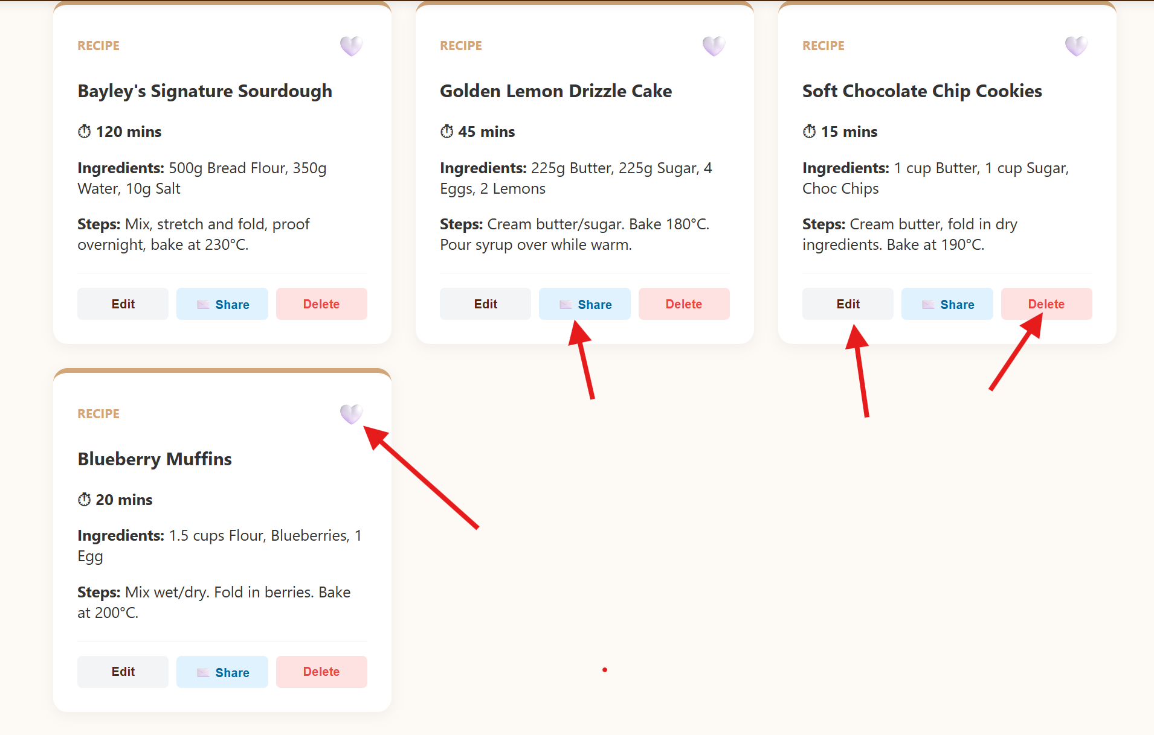
Edit/Delete/Share/Heart
Coded buttons to help improve the user experience! These four recipes are for inspiration and example that are hard-coded into the web application.
Share the recipe over email!
Delete recipe button
Changes? Edit the recipe card!
Heart! For saving as a favourite and moving to top of list

Slide 11
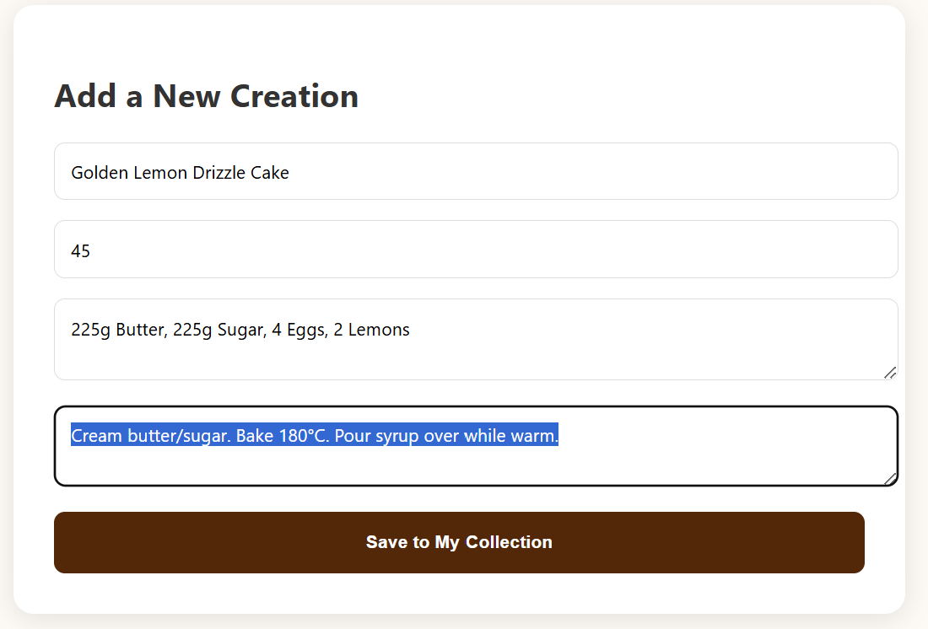
Edit Button:
Auto inputs the data from the recipe card into the form that allows for new recipes to created or edited by the user.

Slide 12
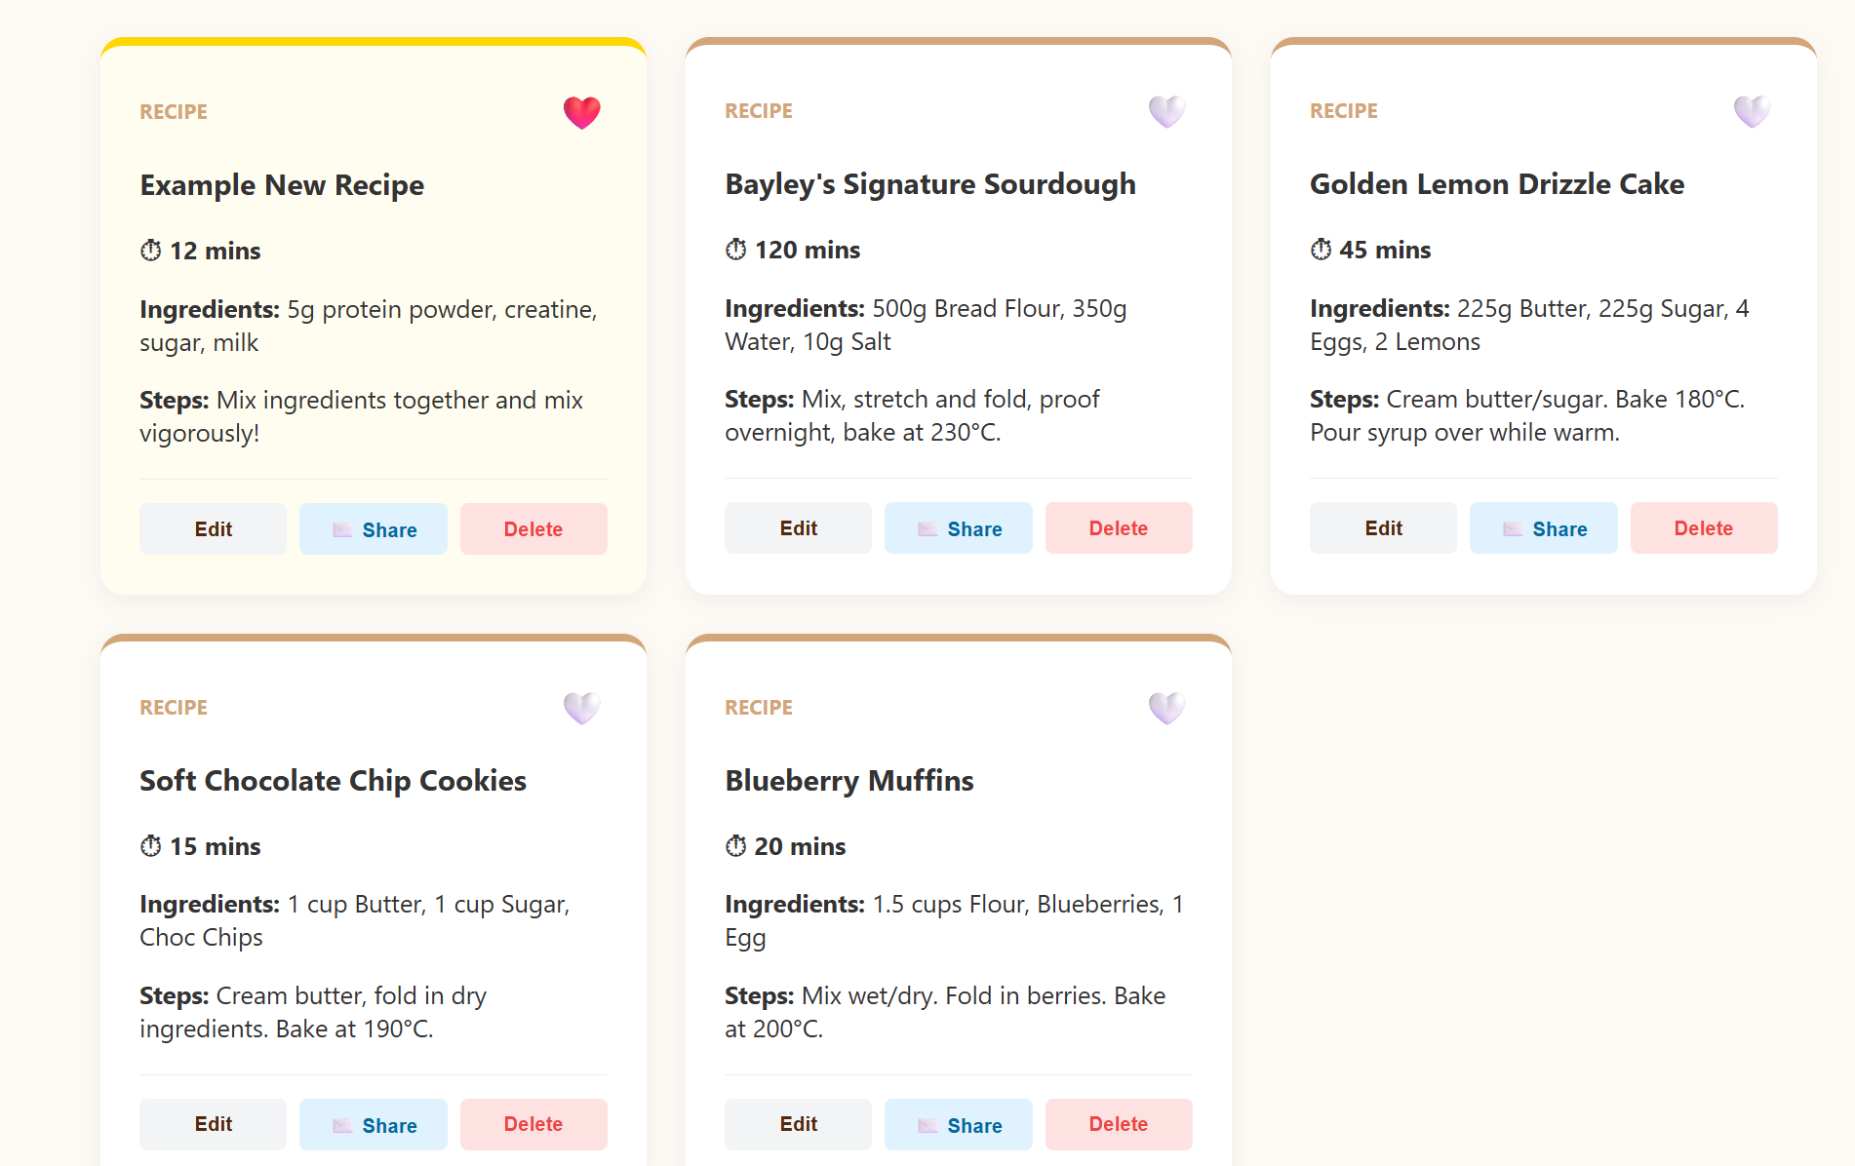
New Recipe Addition + Heart Button
Create a new recipe for the collection and use the heart to bring it to the top of the list!

Slide 13

Changes from Phase 1

Slide 14

Storage Technology (Changed in Final PP)
I decided to change the idea from Phase 1 to just include local storage in the browser of the user. This is going to give users the capability of accessing the data offline because the data is stored in the index.html, there is no network lag because it is not dependant upon outside servers, and it is free without need for paying for a external storage entity.

Slide 15
Addition of Buttons
When I created the base html and started to change the style of the web application, it seemed to be missing something. I added the buttons(edit/delete/share/favourite) on the recipe cards to help with user interface and organization!

Slide 16
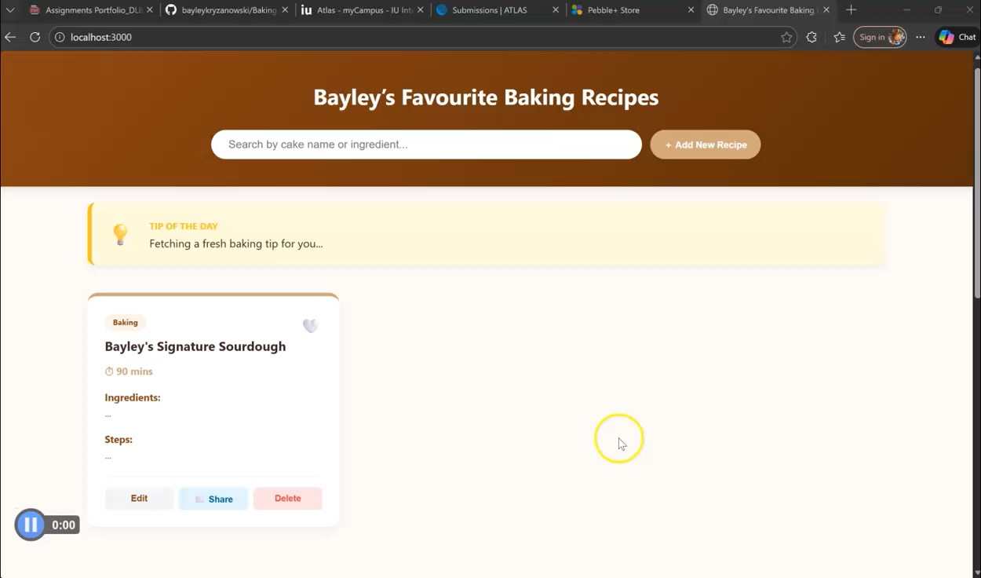
Screen Cast (Updated for Phase 3)

